Slide 1
Fast File, Log and Journaling File Systems cs262a, Lecture 3
Ali Ghodsi and Ion Stoica
(based on presentations from John Kubiatowicz, UC Berkeley, and Arvind Krishnamurthy, from University of Washington)

Slide 2
From Last Lecture

Slide 3
Unix vs. System R: Philosophy
Bottom-Up (elegance of system) vs. Top-Down (elegance of semantics)
UNIX main function: present hardware to computer programmers
small elegant set of mechanisms, and abstractions for developers (i.e. C programmers)
System R: manage data for application programmer
complete system that insulated programmers (i.e. SQL + scripting) from the system, while guaranteeing clearly defined semantics of data and queries.

Slide 4
Unix vs. System R: Philosophy
Bottom-Up (elegance of system) vs. Top-Down (elegance of semantics)
Affects where the complexity goes: to system, or end-programmer?
Which one is better? In what environments?

Slide 5
Turing Awards
Relational databases related:
1981: Edgar Codd
1988: Jim Gray
2015: Mike Stonebraker
Unix related
1983: Ken Thomson and Dennis Ritchie
1990: Fernando Corbato

Slide 6
Today’s Papers
A Fast File System for UNIX Marshall Kirk McKusick, William N. Joy, Samuel J. Leffler and Robert S. Fabry. Appears in ACM Transactions on Computer Systems (TOCS), Vol. 2, No. 3, August 1984, pp 181-197
Analysis and Evolution of Journaling File Systems Vijayan Prabhakaran, Andrea C. Arpaci-Dusseau, and Remzi H. Arpaci-Dusseau, Proceedings of the Annual Conference on USENIX Annual Technical Conference (ATEC '05), 2005
System design paper and system analysis paper

Slide 7
Why Today’s Papers?
After all SSDs are taking over…

Slide 8
Why Today’s Papers?
HDDs still used to store very large data sets cost effectively

Slide 9
Why Today’s Papers?
HDDs still used to store very large data sets cost effectively
More and more distributed storage systems
Performance pattern resemble disks, e.g.,
Low throughput for random access, high throughput for sequential access
Great examples of system engineering
Valuable lessons for other application domains

Slide 10
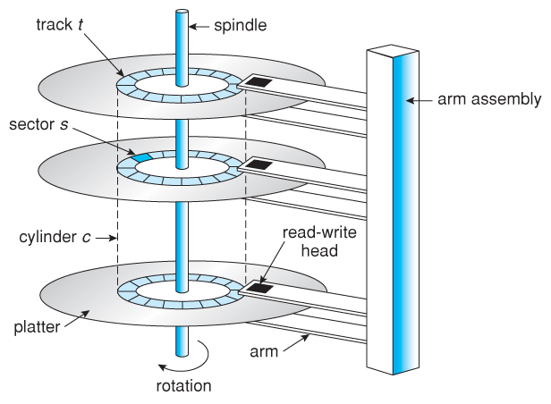
Review: Magnetic Disks

Slide 11
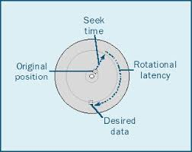
Review: Magnetic Disks
Track
Sector
Cylinders: all the tracks under the head at a given point on all surface
Read/write data is a three-stage process:
Seek time: position the head/arm over the proper track
Rotational latency: wait for desired sector to rotate under r/w head
Transfer time: transfer a block of bits (sector) under r/w head
Head
Cylinder
Platter
Seek time = 4-8m
One rotation = 1-2ms (3600-7200 RPM)

Slide 12
Review: Magnetic Disks
Track
Sector
Cylinders: all the tracks under the head at a given point on all surface
Read/write data is a three-stage process:
Seek time: position the head/arm over the proper track
Rotational latency: wait for desired sector to rotate under r/w head
Transfer time: transfer a block of bits (sector) under r/w head
Head
Cylinder
Platter
Disk Latency = Queueing Time + Controller time +
Seek Time + Rotation Time + Xfer Time
Software
Queue
(Device Driver)
Hardware
Controller
Media Time
(Seek+Rot+Xfer)
Request
Result

Slide 13
Review: Magnetic Disks
Track
Sector
Cylinders: all the tracks under the head at a given point on all surface
Read/write data is a three-stage process:
Seek time: position the head/arm over the proper track
Rotational latency: wait for desired sector to rotate under r/w head
Transfer time: transfer a block of bits (sector) under r/w head
Head
Cylinder
Platter
Disk Latency = Queueing Time + Controller time +
Seek Time + Rotation Time + Xfer Time
Highest Bandwidth: Transfer large group of blocks sequentially from one track

Slide 14
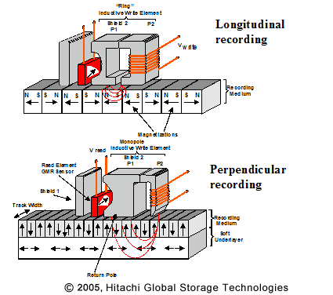
Historical Perspective
IBM Ramac
1956 IBM Ramac — early 1970s Winchester
Developed for mainframe computers, proprietary interface
Steady shrink in form factor from 24in to 17in
1970s developments
8 inch floppy disk form factor (microcode into mainframe)
Emergence of industry standard disk interfaces
1980s: PCs, first generation workstations, and client server computing
Centralized storage on file server
Accelerate disk downsizing: 8inch inch to 5.25 inch
Mass market disk drives become a reality
Industry standards: SCSI, IDI; end of proprietary standards
5.25 inch to 3.5 inch drives PCs
1990s: Laptops → 2.5inch
2000s: Switch to perpendicular (vs longitudinal) recording
2007: 1TB
2009: 2TB
2016: 12TB

Slide 15
Recent: Western Digital Ultrastar
12 TB (April, 2017)
8 platters, 16 heads
7200 RPMs
Max 255MB/s transfer rate
Average latency: 4.2ms
Seek time: 8ms
Helium filled: reduce friction and power usage

Slide 16
HDD vs SSD Comparison

Slide 17
Largest SSDs
60TB (Seagate, August 16)
Dual 16Gbps
Seq reads: 1.5GB/s
Seq writes: 1GB/s
Random Read Ops (IOPS): 150K

Slide 18
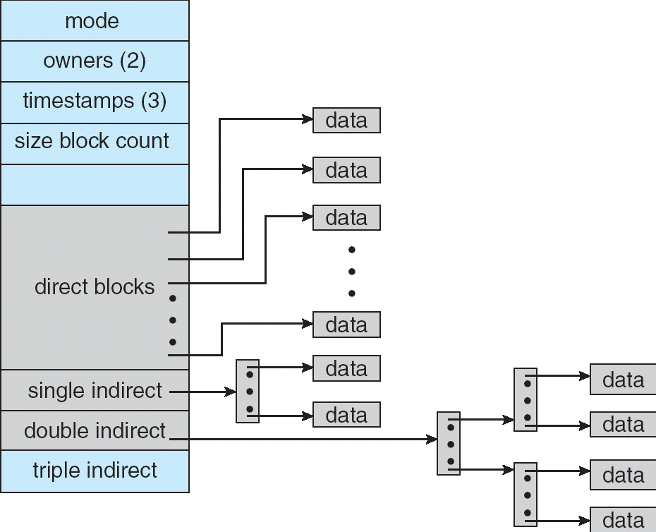
Review: Unix File Systems
i-node: per-file metadata (unique per file)
contains: ownership, permissions, timestamps, ~10 data-block pointers
i-nodes form an array, indexed by “i-number” – so each i-node has a unique i-number
Array is explicit for FFS, implicit for LFS (its i-node map is cache of i-nodes indexed by i-number)
Indirect blocks:
i-node only holds a small number of data block pointers (direct pointers)
For larger files, i-node points to an indirect block containing 1024 4-byte entries in a 4K block
Each indirect block entry points to a data block
Can have multiple levels of indirect blocks for even larger files

Slide 19
Original Unix File System
Simple and elegant, but slow
20KB/s, only 2% from disk theoretical bandwidth (1MB/s)
Challenges:
Blocks too small: 512 bytes (matched sector size)
Many seeks
Consecutive blocks of files not close together
All i-nodes at the beginning of the disk, all data after that
i-nodes of directory not close together
Transfer only one block at a time

Slide 20
Old File System
Increase block size to 1024: over 2x higher throughput (why?)
2x higher transfer rate
Fewer indirect blocks, so fewer seeks
Challenges: in time, free list becomes random so performance degrades (because of seeks)

Slide 21
FFS Changes
4096 or 8192 byte block size (why not larger?)
Use cylinder groups (why?)
Each contains superblock, i-nodes, bitmap of free blocks, usage summary info
Blocks divided into small fragments (why?)
Don’t fill entire disk (why?)

Slide 22
Parametrized Model
New file try to allocate new blocks on same cylinder (why?)
Don’t allocate consecutive blocks (why?)
How do you compute the space between two blocks that are consecutive in the file?

Slide 23
Layout
Principles:
Locality of reference to minimize seek latency
Improve the layout of data to optimize larger transfers
inodes of files in same directory together (why?)
New directories in cylinder groups that have higher than average free blocks (why?)
Try to store all data blocks of a file in the same cylinder group
Preferably at rotationally optimal positions in the same cylinder
Move to other cylinder group when files grow (which one?) Greedy algorithm:
same cylinder
same cylinder group
quadratically hash cylinder group number
exhaustive search;

Slide 24
FFS Results
20-40% of disk bandwidth for large reads/writes
10-20x original UNIX speeds
Size: 3800 lines of code vs. 2700 in old system
10% of total disk space overhead

Slide 25
FFS System Interface Enhancements
Long file names: from 14 to 255 characters
Advisory file locks (shared exclusive):
Requested by the program: shared or exclusive
Effective only if all programs accessing the same file use them
Process id of holder stored with lock => can reclaim the lock if process is no longer around
Long file names: from 14 to 255 characters
Symbolic links (contrast to hard links)
Atomic rename capability
The only atomic read-modify-write operation, before this there was none
Disk quotas

Slide 26
FFS Summary
3 key features:
Optimize FS implementation for hardware
Measurement-driven design decisions
Locality “wins”
Limitations:
Measurements derived from a single installation
Ignored technology trends
Lessons:
Don’t ignore underlying hardware characteristics
Contrasting research approaches: improve what you’ve got vs. design something new (e.g., Log File Systems)

Slide 27
Log Structured & Journaling File Systems

Slide 28
Log-Structured/Journaling File System
Radically different file system design
Technology motivations:
CPUs outpacing disks: I/O becoming more-and-more a bottleneck
Large RAM: file caches work well, making most disk traffic writes
Problems with (then) existing file systems:
Lots of little writes
Synchronous: wait for disk in too many places
5 seeks to create a new file (rough order):
file i-node (create)
file data
directory entry
file i-node (finalize)
directory i-node (modification time)

Slide 29
LFS Basic Idea
Log all data and metadata with large, sequential writes
Keep an index on log’s contents
Use large memory to provide fast access through caching
Data layout on disk has “temporal locality” (good for writing), rather than “logical locality” (good for reading)
Why is this a good idea?

Slide 30
Two Potential Problems
Floating inodes
Wrap-around: what happens when running out of space?
No longer any big, empty runs available
How to prevent fragmentation?

Slide 31
Floating inodes
When you create a small file (less than a block):
Write data block to memory log
Write file inode to memory log
Write directory block to memory log
Write directory inode to memory log
When memory accumulates to say 1MB or 30s have elapsed, write log to disk as a single write
No seek for writes, but inodes are now floating!

Slide 32
Solving floating inode problem
Need to keep track of current position of inodes
Solution: use an “inode-map”!
inode-map could be large (as many entries as there are files in the file system)
Break inode-map into chunks and cache them
Write out on the log those chunks that have changed
But, how do do you find the chunks of inode-map?

Slide 33
Finding chunks of inode-map?
Solution inode-map-map: map of inode map
Have we solved the problem now?
Yes!
inode-map-map is small enough to be always cached in memory
it is small enough to be written to a fixed (and small position) on the disk (checkpoint region)
write the inode-map-map when file system is unmounted

Slide 34
LFS Disk Wrap-Around
Compact live info to open up large runs of free space
Problem: long-lived information gets copied over-and-over
Thread log through free spaces
Problem: disk fragments, causing I/O to become inefficient again
Solution: segmented log
Divide disk into large, fixed-size segments
Do compaction within a segment; thread between segments
When writing, use only clean segments (i.e. no live data)
Occasionally clean segments: read in several, write out live data in compacted form, leaving some fragments free
Collect long-lived info into segments that never need to be cleaned
No free list or bit map (as in FFS), only a list of clean segments

Slide 35
Analysis and Evolution of Journaling File Systems
Write-ahead logging: commit data by writing it to log, synchronously and sequentially
Later move data to its normal (FFS-like) location
called checkpointing; makes room in the (circular) journal
Better for random writes, slightly worse for big sequential writes
All reads go the the fixed location blocks, not the journal
Journal only read for crash recovery and checkpointing
Much better than FFS (fsck) for crash recovery (Why?)
Ext3/ReiserFS/Ext4 filesystems are the main ones in Linux

Slide 36
How do you commit data and metadata?
Three modes:
Writeback mode
Ordered mode
Data journaling mode

Slide 37
Writeback Mode
Journal only metadata
Write back data and metadata independently
Metadata may have dangling references after a crash (if crash between metadata and data writes)

Slide 38
Ordered Mode
Journal only metadata, but always write data blocks before their referring metadata is journaled
This mode generally makes the most sense and is used by Windows NTFS and IBM’s JFS

Slide 39
Data Journaling Mode
Write both data and metadata to the journal
Huge increase in journal traffic; plus have to write most blocks twice, once to the journal and once for checkpointing (why not all?)

Slide 40
JFS Crash Recovery
Load superblock to find tail/head of the log
Scan log to detect whole committed transactions
There is a commit record
Replay log entries to bring in-memory data structures up to date
This is called “redo logging” and entries must be “idempotent”
Playback is oldest to newest; tail of the log is the place where checkpointing stopped

Slide 41
Semantic Block-level Analysis (SBA)
Idea: interpose special disk driver between the file system and real disk driver
Pros:
captures ALL disk traffic
can use with a black-box file system (no source code needed and can even use via VMWare for another OS)
more insightful than just performance benchmark
Cons:
Must understand disk layout
Really only useful for writes
To use well, drive file system with smart applications that test certain features of the file system (to make the inference easier)

Slide 42
Semantic Trace Playback (STP)
Uses two kinds of interposition:
SBA driver that produces a trace, and
user-level library between app and real file system
User-level library traces dirty blocks and app calls to fsync
Playback:
Given the two traces, STP generates a timed set of commands to the raw disk device – this sequence can be timed to understand performance implications

Slide 43
Semantic Trace Playback (STP)
Claim:
Faster to modify the trace than to modify the file system and simpler and less error-prone than building a simulator
Limited to simple FS changes
Best example usage:
Showing that dynamically switching between ordered mode and data journaling mode actually gets the best overall performance (use data journaling for random writes)

Slide 44
LFS Summary
CPUs outpacing disk speeds; implies that I/O is becoming more-and-more of a bottleneck
Write FS information to a log and treat the log as the truth; rely on in-memory caching for speed
Hard problem: finding/creating long runs of disk space to (sequentially) write log records to
Solution: clean live data from segments, picking segments to clean based on a cost/benefit function
Limitations:
Assumes that files get written in their entirety; else would get intra-file fragmentation in LFS
If small files “get bigger” then how would LFS compare to UNIX?

Slide 45
LFS Observations
Interesting point:
LFS’ efficiency isn’t derived from knowing the details of disk geometry; implies it can survive changing disk technologies (such variable number of sectors/track) better
Lessons:
Rethink your basic assumptions about what’s primary and what’s secondary in a design
In this case, they made the log become the truth instead of just a recovery aid

Slide 46
Backup

Slide 47
Exercise
How would you design differently file-system for SSDs or 3DXPoint?

Slide 48
LFS Segment Cleaning
How to clean a segment?
Segment summary block contains map of the segment
Must list every i-node and file block
For file blocks you need {i-number, block #}

Slide 49
Which segment to clean?
Keep estimate of free space in each segment to help find segments with lowest utilization
Always start by looking for segment with utilization=0…
If utilization of segments being cleaned is U:
write cost = (bytes read & written)/(new bytes written) = 2/(1 – U), if U > 0
write cost increases with U: U = .9 => cost = 20!
need a cost <= 4; → U <= .5

