Slide 1
VM Migration, Containers (Lecture 12, cs262a)
Ali Ghodsi and Ion Stoica,
UC Berkeley
February 28, 2018
(Based in part on
http://web.eecs.umich.edu/~mosharaf/Slides/EECS582/W16/021516-JunchengLiveMigration.pptx)
Notes:
3-D graph
Checklist
What we want to enable
What we have today
How we’ll get there

Slide 2
Today’s Paper
Live Migration of Virtual Machines, C. Clark, K. Fraser, S. Hand, J. Hansen, E. Jul, C. Limpach, I. Pratt, A. Warfield,
NSDI’05
An Updated Performance Comparison of Virtual Machines and Linux Containers, Wes Felter, Alexandre Ferreira, Ram Rajamony, Juan Rubio

Slide 3
VMWare “history”
Mendel
Rosemblum
(Stanford University)
Started by creators of Disco
Initial product: provide VMs for developers to aid with development and testing
Can develop & test for multiple OSes on the same box
Actual, killer product: server consolidation
Enable enterprises to consolidate many lightly used services/systems
Cost reduction, easier to manage
Eventually over 90% of VMWare’s revenue

Slide 4
Migration Motivation
Server becomes overloaded
Multiple VMs on same server are heavily used
Load balance the load (e.g., multiple web servers running in VMs)
Maintenance: update the configuration of a machine
Change/upgrade HDD
Upgrade guest OS (e.g., Xen)
Thus, need to migrate VMs on a different machine

Slide 5
Why VM instead of Process migration?
Avoid complex dependencies between processes and local services
Separation of concerns between users and operators
Users can fully control the software within their VMs
Operators don’t care about what’s inside the VM

Slide 6
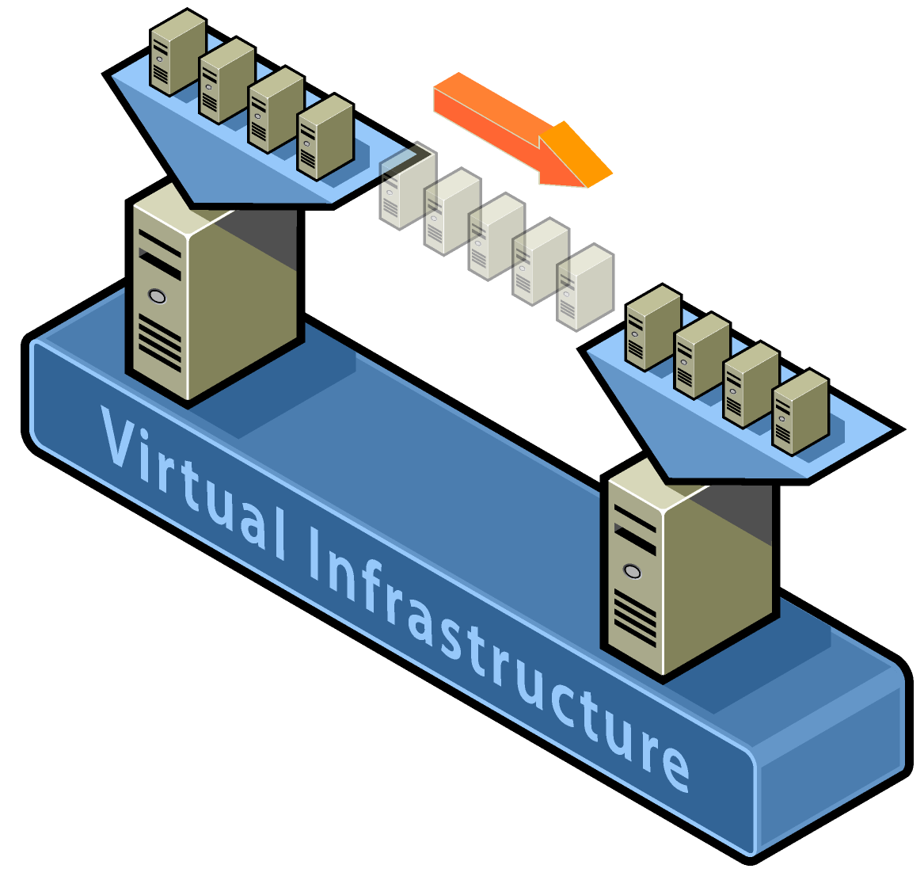
Live VM Migration
Move VMs across distinct physical hosts transparently
Little or no downtime for running services
Services unaware about migration, e.g.,
Maintain network connectivity of the guest OS
VM is treated as a black box

Slide 7
Challenges
Minimize service downtime
Minimize migration duration
Avoid disrupting running service
Source Host
Destination Host
.BIN
.VSV
.XML
Storage
.VHD

Slide 8
Handling Resources during Migration
Open network connections
Keep IP addresses while migrating VM
Use ARP (Address Resolution Protocol) to map IP to new host MAC
Broadcast ARP new routing information
Some routers might ignore to prevent spoofing
However, guest OS aware of migration can avoid this problem
Local storage
Assume Network Attached Storage

Slide 9
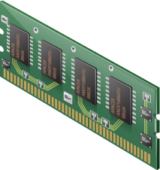
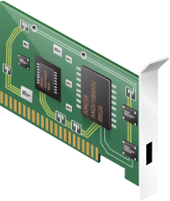
Handling Resources during Migration
Virtual Machine
Virtual Machine
Source
Destination

Slide 10
Migration Techniques
Phase | service downtime | migration duration
push | - | -
stop-and-copy | longest | shortest
pull (demand) | shortest | longest
Pre-copy: bounded
iterative push phase, plus
very short stop-and-copy phase
Careful to avoid service degradation

Slide 11
Design Overview

Slide 12
Migrate Writable Working Sets
Transfer memory pages that are subsequently modified
Good candidates for push phase: pages seldom or never modified.
Writeable working set (WWS): Pages are written often, and should best be transferred via stop-and-copy
WWS behavior
WWS varies significantly between different sub-benchmarks
Migration results depend on workload and when migration happens

Slide 13
Challenge: Migrate Writable Working Sets
Transfer memory pages that are subsequently modified
Good candidates for push phase: Pages seldom or never modified.
Writeable working set (WWS): Pages are written often, and should best be transferred via stop-and-copy
WWS behavior
WWS varies significantly between different sub-benchmarks
Migration results depend on workload and when migration happens

Slide 14
Managed & Self migration
Managed migration
Performed by a migration daemon running in management VM
Self migration
Within migratee OS; a small stub required on destination host
Difference | Managed | Self
Track WWS | shadow page table + bitmap | bitmap + a spare bit in PTE
Stop-and-copy | suspend OS to obtain a consistent checkpoint | two-stage stop-and-copy, ignore page updates in last transfer

Slide 15
Managed Migration (1/2)
Use shadow page table to track dirty pages in each push round
Xen inserts shadow pages under guest OS
Shadow pages are marked read-only
If OS tries to write to a page, resulting page fault is trapped by Xen.
Xen checks OS's original page table and forwards appropriate write permission
Simultaneously, Xen marks page as dirty in bitmap.

Slide 16
Managed Migration (2/2)
At the beginning of next push round
Last round’s bitmap is copied, Xen’s bitmap is cleared
Shadow pages are destroyed and recreated, all write permissions lost

Slide 17
Self Migration
Most implementation within OS being migrated (source machine)
Migration stub must run on destination machine
Listen for incoming migration requests, create an app
Pre-copying scheme similar
Challenge: transfer a consistent OS checkpoint
Cannot suspend migratee (as it is doing migration!)

Slide 18
Logically OS Checkpointing
Disables all OS activity except for migration
Final scan of dirty bitmap; clear bit as each page is transferred.
Pages dirtied during final scan, copied to a shadow buffer
Transfer the contents of the shadow buffer
Page updates are ignored during this transfer.

Slide 19
Dynamic Rate Limiting
downtime
Perfor-mance
Tradeoff:
More network bandwidth less downtime
Less network bandwidth more impact on running services
Dynamically adapt bandwidth limit during each push round
Set a min and a max bandwidth limit, begin with the min limit
$${bandwidth}_{next}={dirty rate}_{current}+constant increment$$
${dirty rate}_{current}=dirty pages/duration$
When terminate push, and switch to stop-and-copy?
${dirty rate}_{current}>{bandwidth}_{max}$
$dirty pages<threshold$ (e.g., 256 KB)

Slide 20
Evaluation-simple web server
Migration starts
A highly loaded server with relative small WWS
Controlled impact on live services
Short downtime

Slide 21
Evaluation-rapid page dirtying
Stop-and-copy
In the third round, the transfer rate is scaled up to 500Mbit/s (max)
Switch to stop-and-copy, resulting in 3.5s downtime
Diabolical workload may suffer considerable service downtime

Slide 22
Conclusion
OS-level live migration
Pre-copy: iterative push and short stop-and-copy
Dynamically adapting network-bandwidth
Balance service downtime and service performance degradation
Minimize service downtime and impact on running service

Slide 23
VMs vs Containers

Slide 25
Linux Containers (LXC)
Linux kernel provides the “control groups” (cgroups) functionality
Allows limitation and prioritization of resources (CPU, memory, block I/O, network, etc)
“namespace isolation” functionality
Allows complete isolation of an applications' view of the OS, e.g.,
Process trees
Networking
User IDs
Mounted file systems.

Slide 26
LXC Features
Runs in the user space
Own process space
Own network interface
Own /sbin/init (coordinates the rest of the boot process and configures the environment for the user)
Run stuff as root
Share kernel with the host
No device emulation

Slide 27
Near-zero overhead
Processes are isolated, but run straight on host
CPU performance = native performance
Memory performance = a few % for (optional) accounting
Network performance = small overhead; can be reduced to zero

Slide 28
Docker
Standard format for containers
Allows to create and share images
Standard, reproducible way to easily build trusted images (Dockerfile)
Public repository of Docker images
https://hub.docker.com/

Slide 29
Kernel-based VM
Hypervisor embedded in the Linux kernel itself
Every VM is a regular Linux process, scheduled by Linux scheduler
KVM makes use of hardware virtualization to virtualize processor states
KVM supports live migration

Slide 30
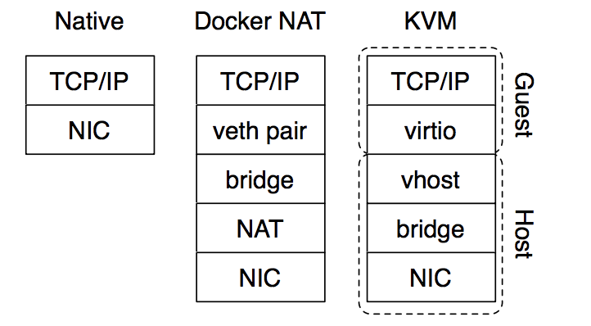
Network Configuration

Slide 31
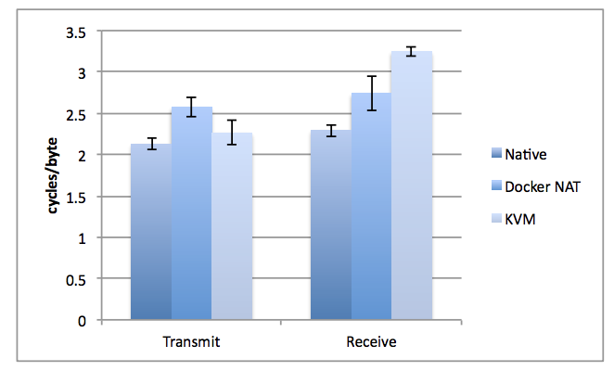
TCP bulk transfer efficiency

Slide 32
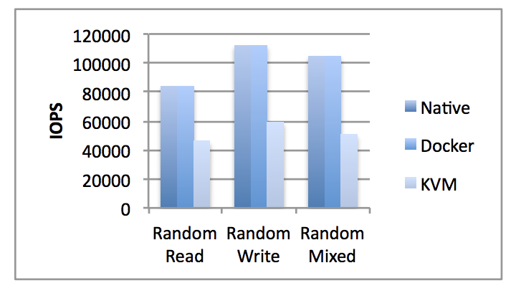
Random I/O Throughput

Slide 33
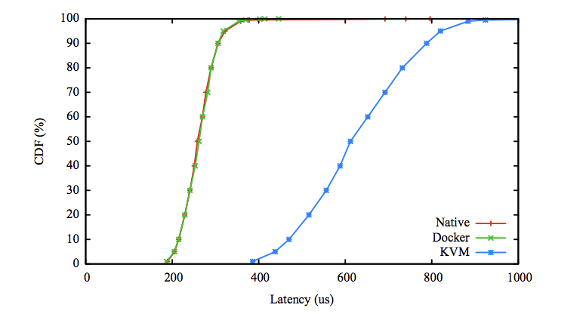
Random read latency CDF

Slide 34
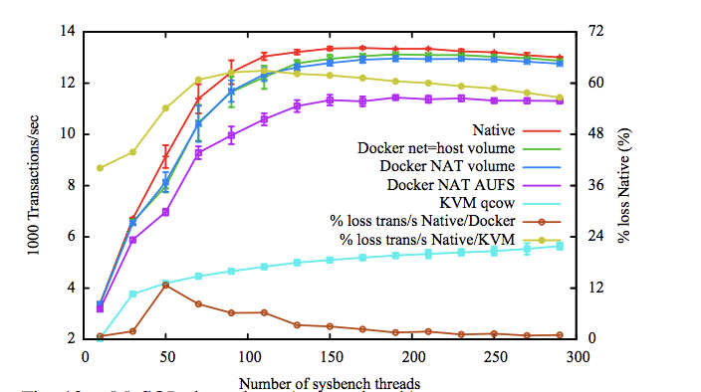
MySQL Throughput vs. Concurrency

Slide 35
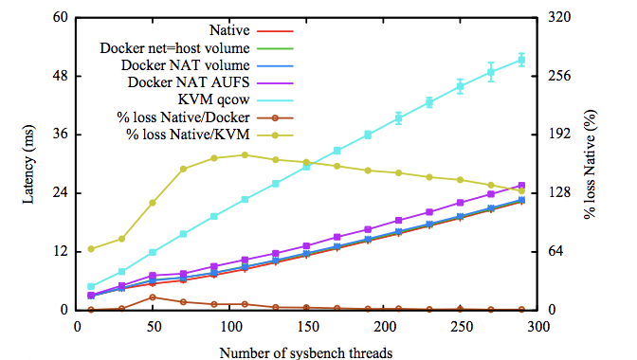
MySQL Throughput vs. Concurrency

Slide 36
Summary
KVM performance has improved considerably since its creation
Leverage virtualization support in modern processors
Docker not without overhead
E.g., NAT introduces overhead for workloads with high packet rates
“Bad” news for containers?
Containers started with near-zero overhead so no room to improve!

