Slide 1
TensorFlow and Clipper (Lecture 24, cs262a)
Ali Ghodsi and Ion Stoica,
UC Berkeley
April 18, 2018
Notes:
3-D graph
Checklist
What we want to enable
What we have today
How we’ll get there

Slide 2
Today’s lecture
Abadi et al., “TensorFlow: A System for Large-Scale Machine Learning”, OSDI 2016
(https://www.usenix.org/system/files/conference/osdi16/osdi16-abadi.pdf)
Crankshaw et al., “Clipper: A Low-Latency Online Prediction Serving System”, NSDI 2017
(https://www.usenix.org/conference/nsdi17/technical-sessions/presentation/crankshaw)

Slide 3
A short history of Neural Networks
1957: Perceptron (Frank Rosenblatt): one layer network neural network
1959: first neural network to solve a real world problem, i.e., eliminates echoes on phone lines (Widrow & Hoff)
1988: Backpropagation (Rumelhart, Hinton, Williams): learning a multi-layered network

Slide 4
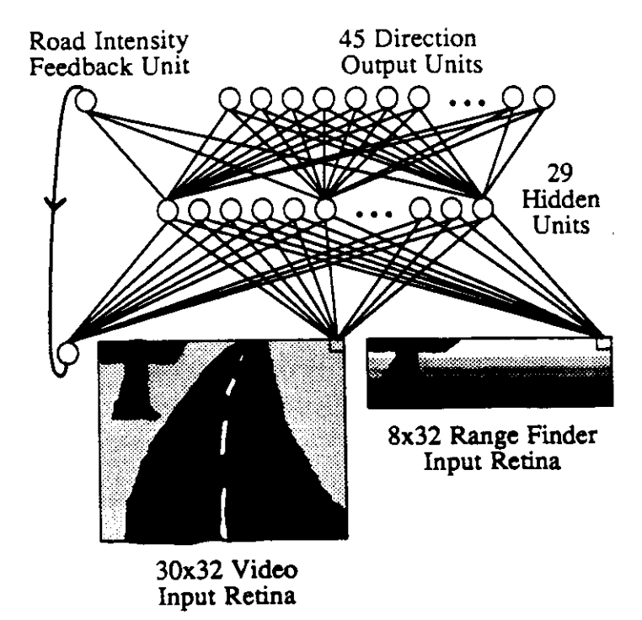
A short history of NNs
1989: ALVINN: autonomous driving car using NN (CMU)
1989: (LeCun) Successful application to recognize handwritten ZIP codes on mail using a “deep” network
2010s: near-human capabilities for image recognition, speech recognition, and language translation

Slide 5
Perceptron
Invented by Frank Rosenblatt (1957): simplified mathematical model of how the neurons in our brains operate
From: http://www.andreykurenkov.com/writing/ai/a-brief-history-of-neural-nets-and-deep-learning/

Slide 6
Perceptron
Could implement AND, OR, but not XOR
From: http://www.andreykurenkov.com/writing/ai/a-brief-history-of-neural-nets-and-deep-learning/

Slide 7
Hidden layers
Hidden layers can find features within the data and allow following layers to operate on those features
Can implement XOR
From: http://www.andreykurenkov.com/writing/ai/a-brief-history-of-neural-nets-and-deep-learning/

Slide 8
Learning: Backpropagation
From: http://www.andreykurenkov.com/writing/ai/a-brief-history-of-neural-nets-and-deep-learning/

Slide 9
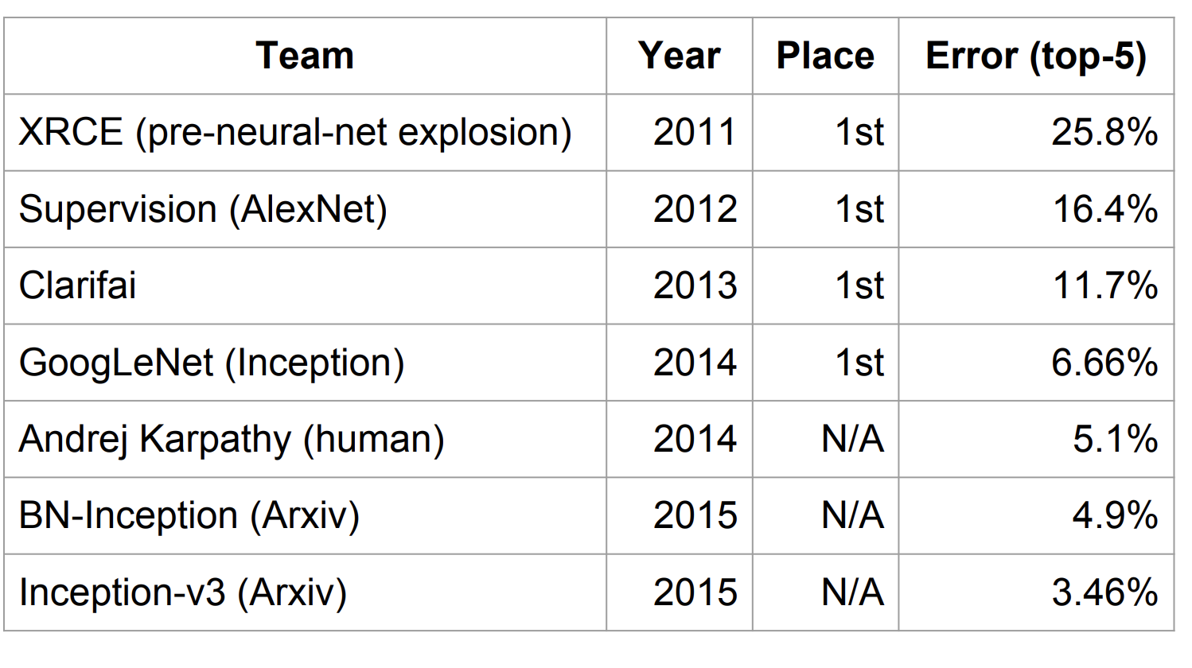
Context (circa 2015)
Deep learning already claiming big successes
Imagenet
challenge
classification
task
From: http://www.wsdm-conference.org/2016/slides/WSDM2016-Jeff-Dean.pdfz

Slide 10
Context (circa 2015)
Deep learning already claiming big successes
Number of developers/researchers exploding
A “zoo” of tools and libraries, some of questionable quality…

Slide 11
What is TensorFlow?
Open source library for numerical computation using data flow graphs
Developed by Google Brain Team to conduct machine learning research
Based on DisBelief used internally at Google since 2011
“TensorFlow is an interface for expressing machine learning algorithms, and an implementation for executing such algorithms”

Slide 12
What is TensorFlow
Key idea: express a numeric computation as a graph
Graph nodes are operations with any number of inputs and outputs
Graph edges are tensors which flow between nodes

Slide 13
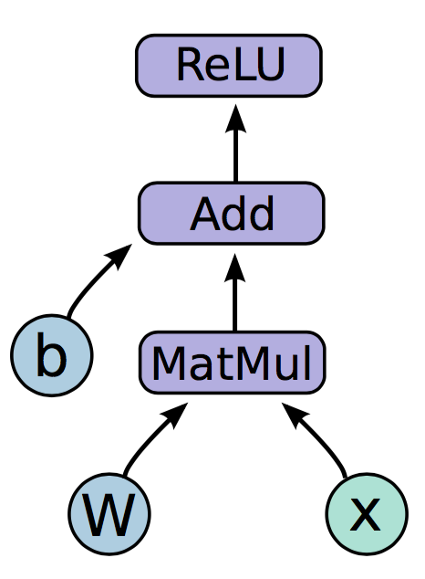
Programming model
Notes:
Neural network with one hidden layer
The function we are computing is on the left. Relu is an activation function that takes the max of 0 and your input, applies a nonlinearity to your network.
The graph on the right is how this function would look like in a tensorflow graph.
Let us break down the nodes in the graph into three types

Slide 14
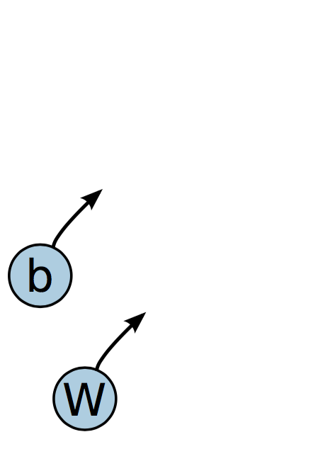
Programming model
Variables are stateful nodes which output their current value. State is retained across multiple executions of a graph
(mostly parameters)
Notes:
We have two variables in this graph, the bias and W matrix.
What we mean by saying that variables are stateful is that they retain their current value over multiple executions, and it’s easy to restore saved values to variables.
Variables have a number of other useful features. They can be saved to disk during and after training, and gradient updates will by default apply over all the variables in your graph
Variables are still operations (nodes = operations!). When you run a variable you get the value of its state.
The variables in your graph are going to be your parameters

Slide 15
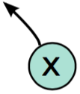
Programming model
Placeholders are nodes whose value is fed in at execution time
(inputs, labels, …)
Notes:
The second important node type is placeholders. If you have inputs into your network that depend on some external data, you want to be able to build your graph without depending on any real values yet, as those are passed in at run time.
Placeholders, unlike variables that have initial assignment, expect as arguments a data type and a shape of a tensor.
Inputs, labels

Slide 16
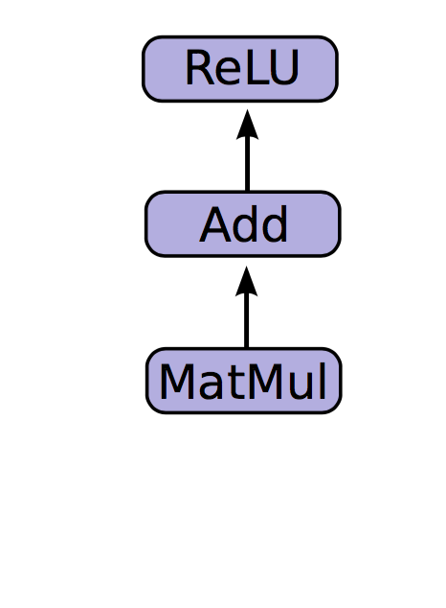
Programming model
Mathematical operations:
MatMul: Multiply two matrices
Add: Add elementwise
ReLU: Activate with elementwise rectified linear function
0, x <= 0
ReLu(x) =
x, x > 0
Notes:
The other nodes are mathematical operations that you are familiar with. Matmul, addition, and relu are all operations in your graph that combine your inputs and parameters to produce new nodes.

Slide 17
Code
import tensorflow as tf b = tf.Variable(tf.zeros((100,))) W = tf.Variable(tf.random_uniform((784, 100), -1, 1)) x = tf.placeholder(tf.float32, (1, 784))
h = tf.nn.relu(tf.matmul(x, W) + b)

Slide 18
Running the graph
Deploy graph with a session: a binding to a particular execution context (e.g. CPU, GPU)
CPU
GPU

Slide 19
End-to-end
So far:
Built a graph using variables and placeholders
Deploy the graph onto a session, i.e., execution environment
Next: train model
Define loss function
Compute gradients

Slide 20
Defining loss
Use placeholder for labels
Build loss node using labels and prediction
prediction = tf.nn.softmax(...) #Output of neural network
label = tf.placeholder(tf.float32, [100, 10])
cross_entropy = -tf.reduce_sum(label * tf.log(prediction), axis=1)

Slide 21
Gradient computation: Backpropagation
train_step = tf.train.GradientDescentOptimizer(0.5).minimize(cross_entropy)
tf.train.GradientDescentOptimizer is an Optimizer object
tf.train.GradientDescentOptimizer(lr).minimize(cross_entropy) adds optimization operation to computation graph
TensorFlow graph nodes have attached gradient operations
Gradient with respect to parameters computed with backpropagation … automatically

Slide 22
Design Principles
Dataflow graphs of primitive operators
Deferred execution (two phases)
Define program i.e., symbolic dataflow graph w/ placeholders
Executes optimized version of program on set of available devices
Common abstraction for heterogeneous accelerators
Issue a kernel for execution
Allocate memory for inputs and outputs
Transfer buffers to and from host memory

Slide 23
Dynamic Flow Control
Problem: support ML algos that contain conditional and iterative control flow, e.g.
Recurrent Neural Networks (RNNs)
Long-Short Term Memory (LSTM)
Solution: Add conditional (if statement) and iterative (while loop) programming constructs

Slide 24
TensorFlow high-level architecture
Core in C++
Very low overhead
Different front ends for specifying/driving the computation
Python and C++ today, easy to add more
From: http://www.wsdm-conference.org/2016/slides/WSDM2016-Jeff-Dean.pdf

Slide 25
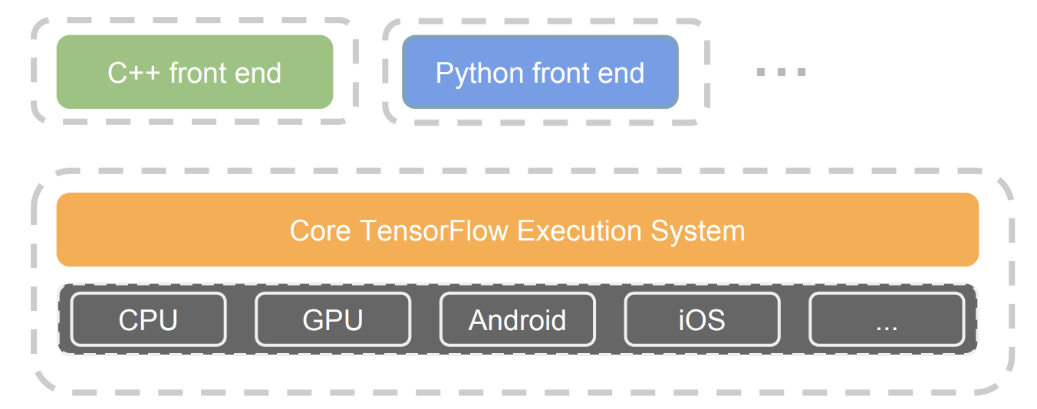
TensorFlow architecture
Core in C++
Very low overhead
Different front ends for specifying/driving the computation
Python and C++ today, easy to add more
From: http://www.wsdm-conference.org/2016/slides/WSDM2016-Jeff-Dean.pdf

Slide 26
Detailed architecture
From: https://www.tensorflow.org/extend/architecture

Slide 27
Key components
Similar to MapReduce, Apache Hadoop, Apache Spark, …
From: https://www.tensorflow.org/extend/architecture

Slide 28
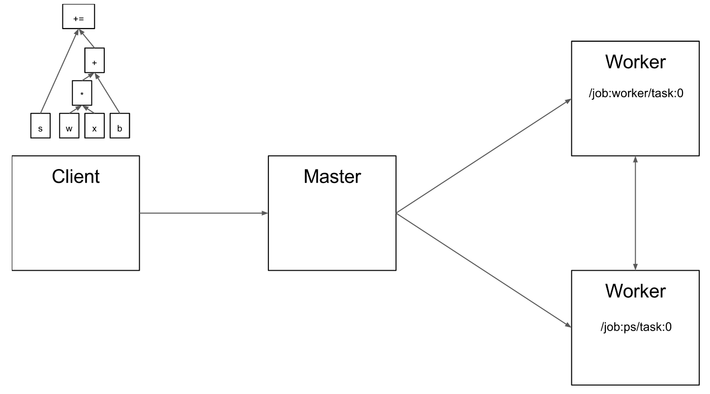
Client
From: https://www.tensorflow.org/extend/architecture

Slide 29
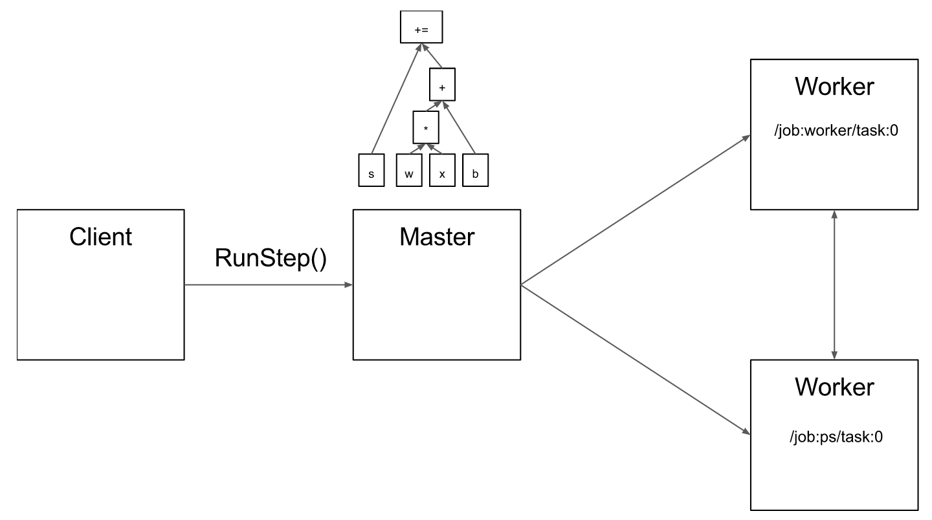
Master
From: https://www.tensorflow.org/extend/architecture

Slide 30
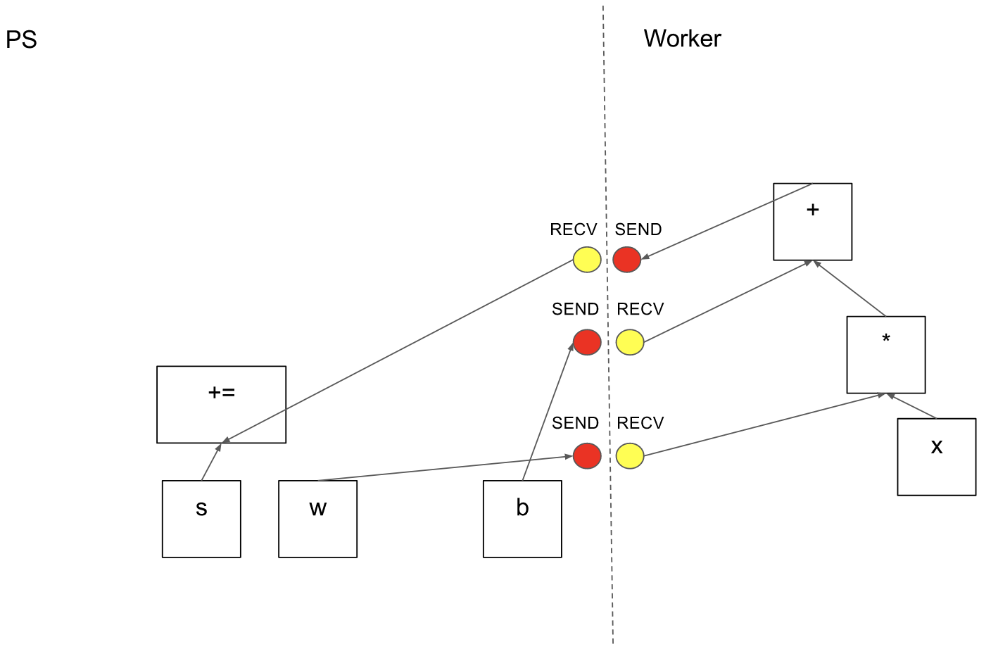
Computation graph partition
From: https://www.tensorflow.org/extend/architecture

Slide 31
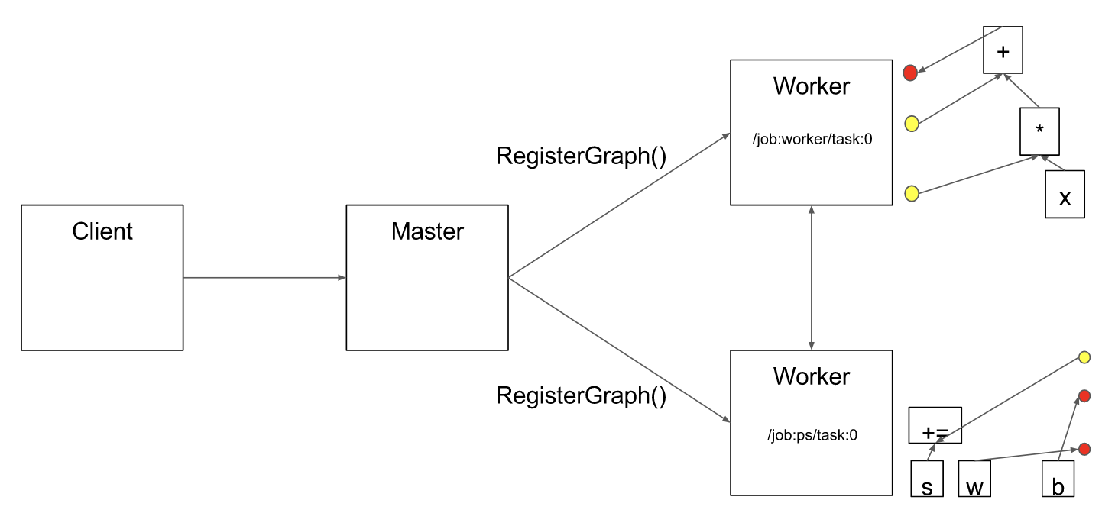
Computation graph partition
From: https://www.tensorflow.org/extend/architecture

Slide 32
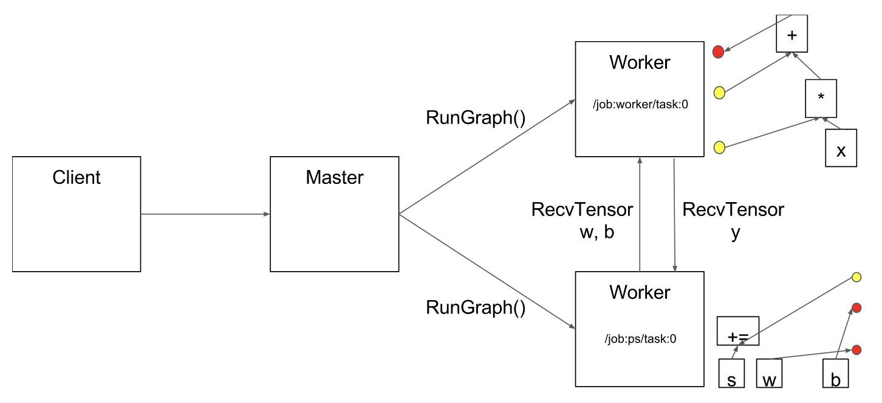
Execution
From: https://www.tensorflow.org/extend/architecture

Slide 33
Fault Tolerance
Assumptions:
Fine grain operations: “It is unlikely that tasks will fail so often that individual operations need fault tolerance” ;-)
“Many learning algorithms do not require strong consistency”
Solution: user-level checkpointing (provides 2 ops)
save(): writes one or more tensors to a checkpoint file
restore(): reads one or more tensors from a checkpoint file

Slide 34
Discussion
Eager vs. deferred (lazy) execution
Transparent vs. user-level fault tolerance
Easy of use

Slide 35
Discussion
 | OpenMP/Cilk | MPI | MapReduce / Spark
Environment, Assumptions | Single node, multiple core, shared memory | Supercomputers Sophisticate programmers High performance Hard to scale hardware | Commodity clusters Java programmers Programmer productivity Easier, faster to scale up cluster
Computation Model | Fine-grained task parallelism | Message passing | Data flow / BSP
Strengths | Simplifies parallel programming on multi-cores | Can write very fast asynchronous code | Fault tolerance
Weaknesses | Still pretty complex, need to be careful about race conditions | Fault tolerance Easy to end up with non-deterministic code (if not using barriers) | Not as high performance as MPI

