Slide 1
Inception-v4, Inception-ResNet and
the Impact of
Residual Connections on Learning

Slide 2
History
What is convolutional neural network?
Why is it so important?

Slide 3
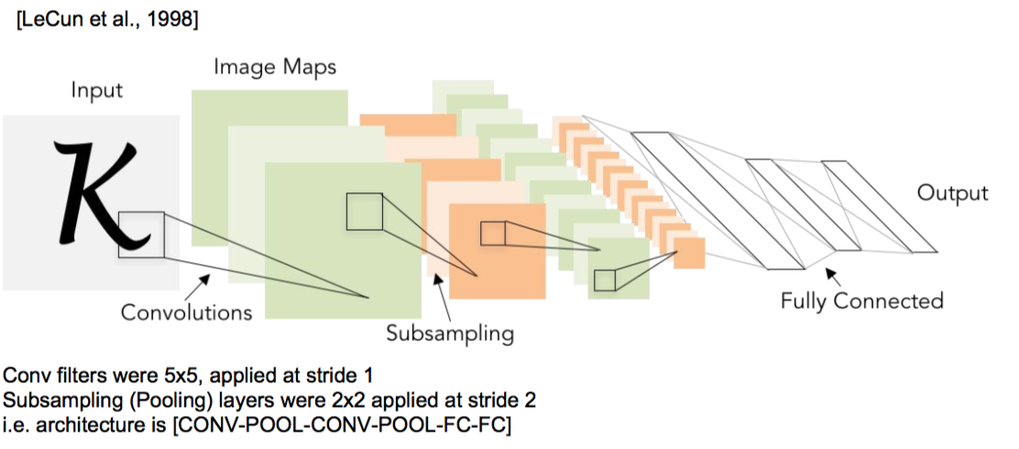
History
Link: 2D Visualization (http://scs.ryerson.ca/~aharley/vis/conv/flat.html)
3D Visualization (http://scs.ryerson.ca/~aharley/vis/conv/)
Taken from slides of CS231n course at Stanford University
Notes:
Will talk about the LeNet and also explain the basics of CNN using those 2D and 3D visualization links at the bottom of the slide

Slide 4
History
Taken from slides of CS231n course at Stanford University

Slide 5
History
Taken from slides of CS231n course at Stanford University

Slide 6
History
Taken from slides of CS231n course at Stanford University

Slide 7
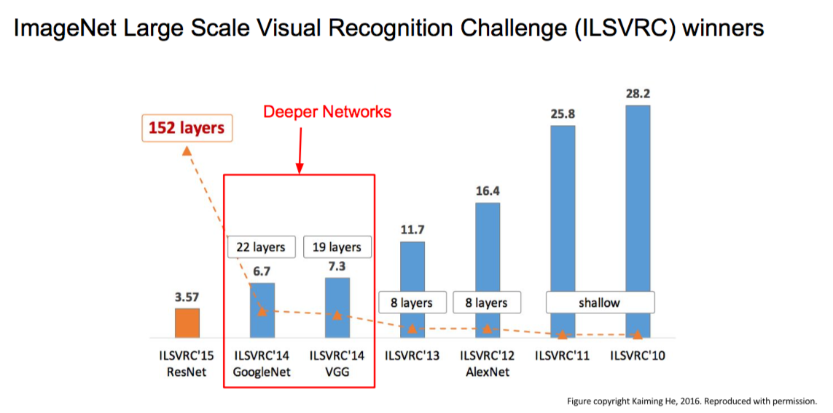
History
Taken from slides of CS231n course at Stanford University

Slide 8
History
Taken from slides of CS231n course at Stanford University

Slide 9
GoogLeNet (Inception Modules)
Taken from slides of CS231n course at Stanford University

Slide 10
GoogLeNet (Inception Modules)
Taken from slides of CS231n course at Stanford University

Slide 11
GoogLeNet (Inception Modules)
1 x 1 convolutions
Taken from slides of CS231n course at Stanford University

Slide 12
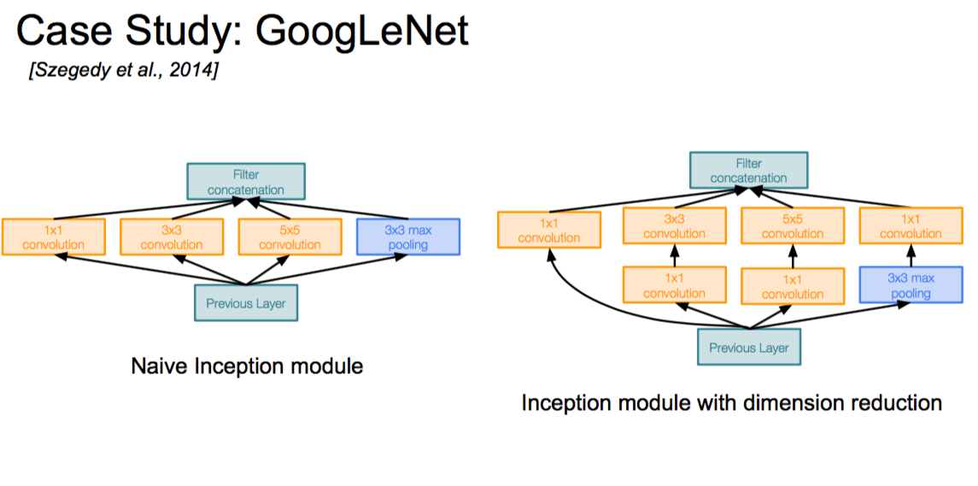
GoogLeNet (Inception Modules)
Taken from slides of CS231n course at Stanford University

Slide 13
GoogLeNet (Inception Modules)
Taken from slides of CS231n course at Stanford University

Slide 14
GoogLeNet (Inception Modules)
Stack inception modules with dimension reduction on top of each other
Taken from slides of CS231n course at Stanford University

Slide 15
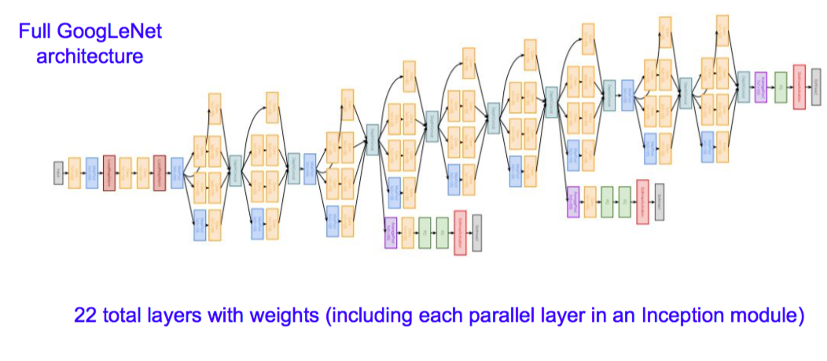
GoogLeNet (Inception Modules)
Taken from slides of CS231n course at Stanford University

Slide 16
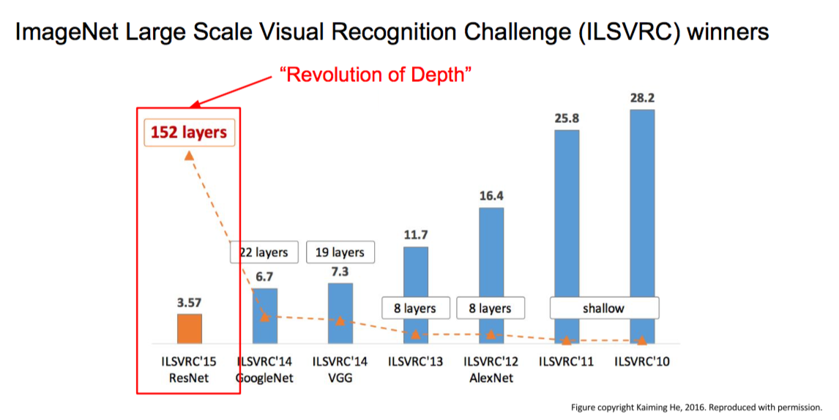
Taken from slides of CS231n course at Stanford University

Slide 17
ResNet (Identity Mapping)
Taken from slides of CS231n course at Stanford University

Slide 18
ResNet (Identity Mapping)
56-layer model performs worse on both training and test error
The deeper model performs worse, but it’s not caused by overfitting!
Taken from slides of CS231n course at Stanford University

Slide 19
ResNet (Identity Mapping)
Taken from slides of CS231n course at Stanford University

Slide 20
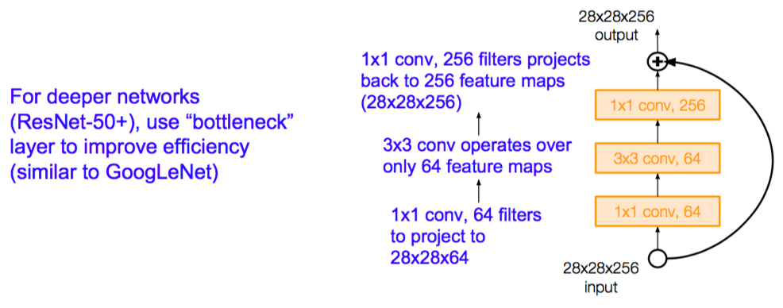
ResNet (Identity Mapping)
Taken from slides of CS231n course at Stanford University

Slide 21
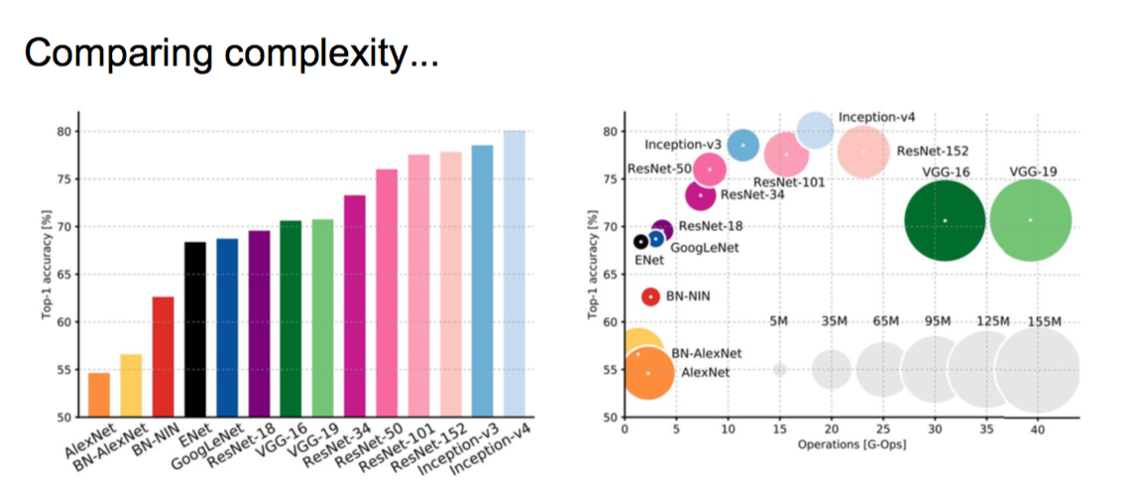
Until Now ...
Taken from slides of CS231n course at Stanford University

Slide 22
Inception-v4, Inception-ResNet and
the Impact of Residual Connections on Learning
(
)
v/s
v/s
+
Inception v1, v2 ..
ResNet v1, v2 ..
Inception ResNet v1, v2 ...

Slide 23
What is the problem being solved?
To gain a better performance over the SOTA in ILSVRC 2015.

Slide 24
What is the problem being solved?
To gain a better performance over the SOTA in ILSVRC 2015.
To show that training with residual connections accelerates the training of inception networks significantly.
Compare residual and non-residual inception networks.
Show that an ensemble of three residual and one Inception-v4 you can establish a new SOTA.

Slide 25
What are the metrics of success?
Top-1 error
Top-3 error
Top-5 error

Slide 26
What are the metrics of success?
Top-1 error
Top-3 error
Top-5 error
Top-1 error
If the correct answer is the same as top 1 predicted answer by the model.
Top-3 error
If the correct answer is within the top 3 predicted answers of the model.
Top-5 error
If the correct answer is within the top 5 predicted answers of the model.

Slide 27
What is the proposed idea/method/
technique/system?
Training using TensorFlow without partitioning the replicas.
This is enabled in part by recent optimizations of memory used by backpropagation, achieved by carefully considering what tensors are needed for gradient computation and structuring the computation to reduce the number of such tensors.
Simplifying Inception-v3 and make uniform choices for inception blocks for each grid size
Not simplifying earlier choices in Inception-v3 resulted in networks that looked more complicated that they needed to be. In the newer experiments, for Inception-v4 they shed the unnecessary baggage and made uniform choices for the Inception blocks for each grid size.

Slide 28
What is the proposed idea/method/
technique/system?
Training using TensorFlow without partitioning the replicas.
This is enabled in part by recent optimizations of memory used by backpropagation, achieved by carefully considering what tensors are needed for gradient computation and structuring the computation to reduce the number of such tensors.
Simplifying Inception-v3 and make uniform choices for inception blocks for each grid size
Not simplifying earlier choices in Inception-v3 resulted in networks that looked more complicated that they needed to be. In the newer experiments, for Inception-v4 they shed the unnecessary baggage and made uniform choices for the Inception blocks for each grid size.

Slide 29
What is the key innovation over prior work?
Inception-v3
improvement
Inception-v4
Inception ResNet v1, v2..
innovation
ResNet

Slide 30
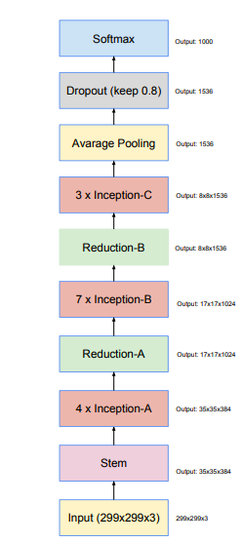
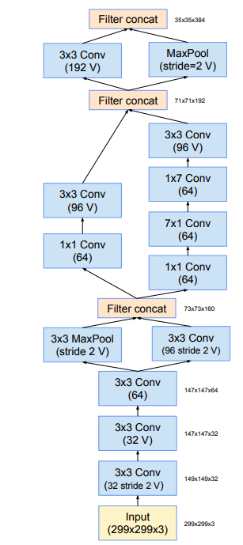
Inception-v4

Slide 31
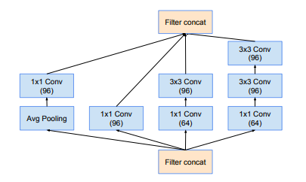
Inception-v4

Slide 32
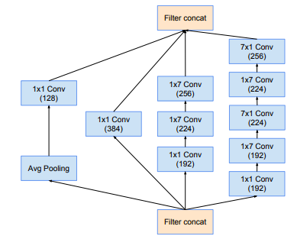
Inception-v4

Slide 33
Inception-v4

Slide 34
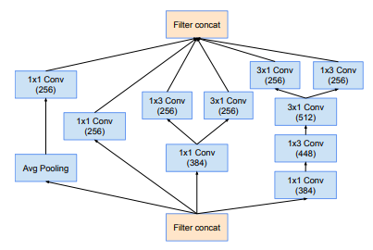
Inception-v4
Reduction Module

Slide 35
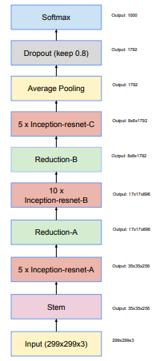
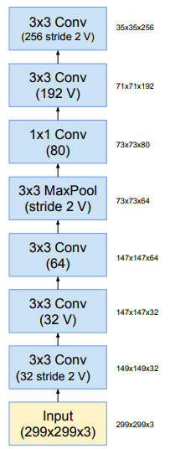
Inception ResNet-v1

Slide 36
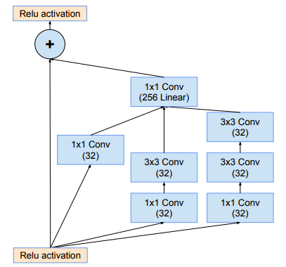
Inception ResNet-v1

Slide 37
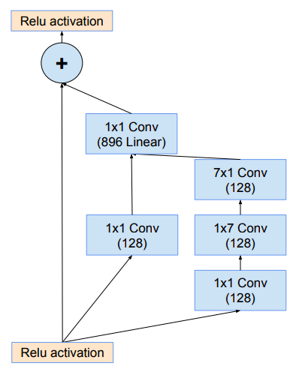
Inception ResNet-v1

Slide 38
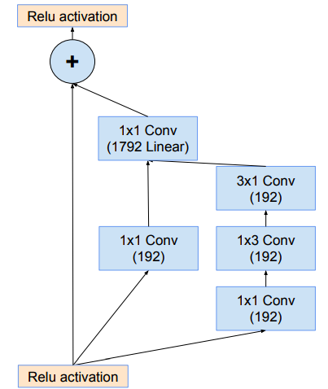
Inception ResNet-v1

Slide 39
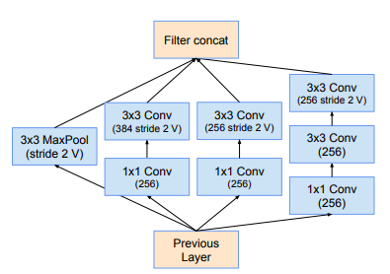
Inception ResNet-v1
Reduction Module

Slide 40
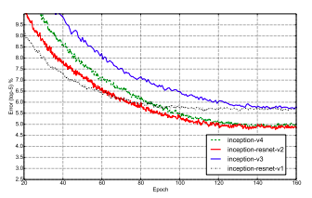
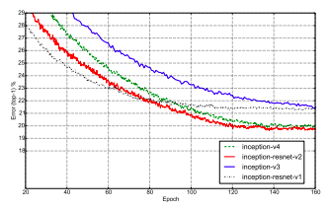
Key Results
Top 5 error evolution of all 4 models during training.
Top 1 error evolution of all 4 models during training.

Slide 41
Key Results
Inception-ResNet-v1: a hybrid Inception version that has a similar computational cost to Inception-v3
Inception-ResNet-v2: a costlier hybrid Inception version with significantly improved recognition performance
Inception-v4: a pure Inception variant without residual connections with roughly the same recognition performance as Inception-ResNet-v2.

Slide 42
Key Results
Ensemble results

Slide 43
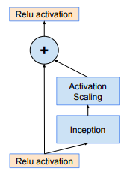
Limitations
If the number of filters exceeded 1000, the residual variants started to exhibit instabilities and the network has just “died” early in the training,
Meaning that the last layer before the average pooling started to produce only zeros after a few tens of thousands of iterations.
This could NOT be prevented, neither by lowering the learning rate, nor by adding an extra batch-normalization to this layer.
Notes:
We found that scaling down the residuals before adding them to the previous layer activation seemed to stabilize the training. In general we picked some scaling factors between 0.1 and 0.3 to scale the residuals before their being added to the accumulated layer activations (cf. Figure 20).
A similar instability was observed by He et al. in [5] in the case of very deep residual networks and they suggested a two-phase training where the first “warm-up” phase is done with very low learning rate, followed by a second phase with high learning rata. We found that if the number of filters is very high, then even a very low (0.00001) learning rate is not sufficient to cope with the instabilities and the training with high learning rate had a chance to destroy its effects. We found it much more reliable to just scale the residuals.

Slide 44
Long Term Impact
Introduction of residual connections led to dramatically improved training speed for the Inception architecture.
Also the latest models (with and without residual connections) outperform all the previous networks, just by virtue of the increased model size.

Slide 45
Thank You

