Slide 1
CS294: RISE Logistics, Overview, Trends
Joey Gonzalez, Joe Hellerstein, Raluca Popa, Ion Stoica
August 29, 2016

Slide 3
Goal of this Class
Bootstrap RISE research agenda
Start new projects or work on existing ones
Read related work in the areas relevant to RISE Lab
ML, Security, Systems/Databases, Architecture
Allow people from one area learn about state-of-the-art research in other areas → key to success in an interdisciplinary effort

Slide 4
Course Information
Course website is:
https://ucbrise.github.io/cs294-rise-fa16/
It is on Github so you can contribute content!
We will be adding a few more updates today and tomorrow
We will be using Piazza for discussion about the class
https://piazza.com/berkeley/fall2016/cs29420/home

Slide 5
Tentative Lecture Format (not today!)
First 1/3 of each lecture presented by faculty
Second 2/3 covers papers presented by students
Reading assignments should be up several weeks in advance
All students are required to read all papers
All students must answer short questions on google form
Student will prepare 15 minute presentations on selected paper
We will post on Piazza about how to signup later this week
Address the questions in the form
Identify key insights, strengths and weaknesses, and implications on RISE research agenda

Slide 6
Grading Policy
50% Class Participation
Answer questions, join discussion, and present papers
10% Initial Project Proposal Presentation
Presented in class on 10/17
20% Final Project Presentation
During class final exam 12/12
20% Final Project Report
Emailed to instructors 12/16 by 11:59 PM

Slide 7
Rest of This Talk
Reflect on how
Application trends (i.e., user needs & requirements)
Hardware trends
have impacted the design of our solution
How we can use these lessons to design new systems in the context of RISE Lab

Slide 8
The Past and The Lessons

Slide 9
2009: State-of-the-art in Big Data
Hadoop
Large scale, flexible data processing engine
Fault tolerant
Batch computation (e.g., 10s minutes to hours)
Getting rapid industry traction:
High profile users: Facebook, Twitter, Yahoo!, …
Distributions: Cloudera, Hortonworks
Many companies still in austerity mode

Slide 10
2009: Application Trends
Interactive computations, e.g., ad-hoc analytics
SQL engines like Hive and Pig drove this trend
Iterative computations, e.g., Machine Learning
More and more people aiming to get insights from data

Slide 11
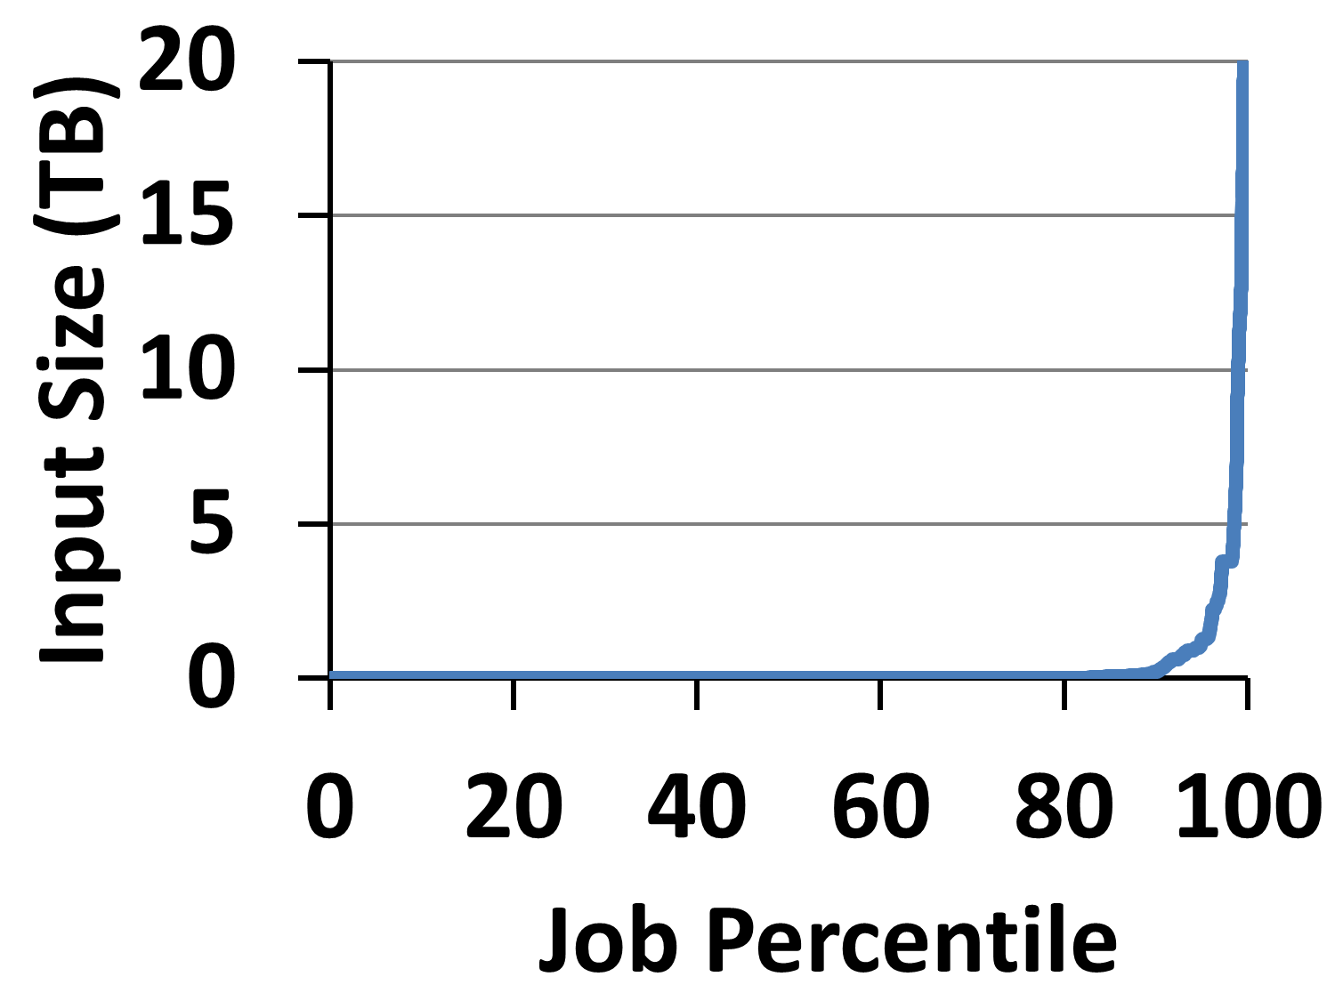
2009: Application Trends
Despite huge amounts of data, many working sets in big data clusters fit in memory
Inputs of 96% of Facebook jobs fit in memory*
*G Ananthanarayanan, A. Ghodsi, S. Shenker, I. Stoica, ”Disk-Locality in Datacenter Computing Considered Irrelevant”, HotOS 2011

Slide 12
2009: Application Trends
Memory (GB) | Facebook (% jobs) | Microsoft (% jobs) | Yahoo! (% jobs)
8 | 69 | 38 | 66
16 | 74 | 51 | 81
32 | 96 | 82 | 97.5
64 | 97 | 98 | 99.5
128 | 98.8 | 99.4 | 99.8
192 | 99.5 | 100 | 100
256 | 99.6 | 100 | 100
*G Ananthanarayanan, A. Ghodsi, S. Shenker, I. Stoica, ”Disk-Locality in Datacenter Computing Considered Irrelevant”, HotOS 2011

Slide 13
2009: Application Trends
Memory (GB) | Facebook (% jobs) | Microsoft (% jobs) | Yahoo! (% jobs)
8 | 69 | 38 | 66
16 | 74 | 51 | 81
32 | 96 | 82 | 97.5
64 | 97 | 98 | 99.5
128 | 98.8 | 99.4 | 99.8
192 | 99.5 | 100 | 100
256 | 99.6 | 100 | 100
*G Ananthanarayanan, A. Ghodsi, S. Shenker, I. Stoica, ”Disk-Locality in Datacenter Computing Considered Irrelevant”, HotOS 2011

Slide 14
2009: Hardware Trends
Memory still growing with Moore’s law
I/O throughput and latency stagnant
HDD dominating data clusters as storage of choice

Slide 15
2009: Trends Summary
Users require interactivity and support for iterative apps
Majority of working sets of many workloads fit in memory
Memory capacity still growing fast, while I/O stagnant

Slide 16
2009: Our Solution: Apache Spark
In-memory processing
Generalizes MapReduce to multi-stage computations
Fully implements BSP model

Slide 17
2009: Challenges & Solutions
Low-overhead resilience mechanisms →
Resilient Distributed Datasets (RDDs)
Efficiently support for ML algos →
Share data between stages via memory
Powerful and flexible APIs: map/reduce just two of over 80+ APIs

Slide 18
2012: Application Trends
People started to assemble e2e data analytics pipelines
Need to stitch together a hodgepodge of systems
Raw
Data
ETL
Ad-hoc
exploration
Advanced Analytics
Data Products

Slide 19
2012: Our Solution: Unified Platform
Support a variety of workloads
Support a variety of input sources
Provide a variety of language bindings
Spark SQL interactive
Spark Streaming real-time
MLlib
machine learning
GraphX
graph
Spark Core Python, Java, Scala, R
a
…

Slide 20
2015: Application Trends
New users, new requirements
Spark early adopters
Users
Understands
MapReduce
& functional APIs
Data Engineers
Data Scientists
Statisticians
R users
PyData …

Slide 21
2015: Hardware Trends
Memory capacity continue to grow with Moore’s law
Many clusters and datacenters transitioning to SSDs
DigitalOcean: SSD only instances since 2013
CPU growth slowing down → becoming the bottleneck

Slide 22
2015: Our Solution
Move to schema-based data abstractions, e.g., DataFrames
Familiar to data scientists, e.g., R and Python/pandas
Allows us to in-memory store data in binary format
Much lower overhead
Alleviates/Avoids JVM’s garbage collection overhead
Project Tungsten

Slide 23
2015: Project Tungsten
Substantially speed up execution by optimizing CPU efficiency, via:
Runtime code generation
Exploiting cache locality
Off-heap memory management
Python
DF
Java/Scala
DF
R
DF
Logical Plan
Tungsten
Execution

Slide 24
What’s Next for RISE Lab?

Slide 25
Overview
Application trends
Hardware trends
Challenges and techniques

Slide 26
Application Trends
Data only as valuable as the decisions and actions it enables
What does it mean?
Faster decisions better than slower decisions
Decisions on fresh data better than on stale data
Decisions on personal data better than on aggregate data

Slide 27
Application Trends
Real-time decisions
decide in ms
on live data
the current state as data arrives
with strong security
privacy, confidentiality, and integrity
decide in ms
Notes:
Questions: (Joey: lets talk tomorrow)
add the staleness dimensions: let’s give an example of the technologies required to reach each point today
why you cannot do it today? : Why can’t we move out to the far right: need to tradeoff accuracy, need fast point queries into massive materialized spaces. Need to keep materialized views up to date
talk about smooth tradeoff? Maybe too complicated? : New algorithms and models to allow elastic tradeoff of accuracy (prediction error), recency (fresh data), and latency (prediction delay)
say more about robustnes
what do you lose? why you can do it today?
advancements in incremental/streaming ML algorithms
a lot of more memory (can precompute much more)
aggressive sampling (anyway deal with statistic results); evaluate multiple models in parallel to recover robustness;
use duplicate requests to reduce tail latency
give a detailed example
New technologies: disaggregation, shared memory, shared storage, huge memory
For slide 4:
Sophisticated algorithms → ability to adapt to different cost tradeoffs in accuracy, latency, and resource availiability all while quantifying accuracy → Blink DB in serving
We need to quantify what we mean by robustness in machine learning: Robust to noisy data and errors in data
For cost lets also emphasize elastic costs: I can always pay more to improve accuracy, latency and robustness or pay less to get all that I NEED which can only be achieved by quantifying prediction accuracy.
Slide 6:
Add a running example. How do we get to each of the points in this tradeoff space today and what is our insight that will take us to the top right?

Slide 28
Application Trends
Real-time decisions
decide in ms
on live data
the current state as data arrives
with strong security
privacy, confidentiality, and integrity
decide in ms
the current state of the environment
Notes:
Questions: (Joey: lets talk tomorrow)
add the staleness dimensions: let’s give an example of the technologies required to reach each point today
why you cannot do it today? : Why can’t we move out to the far right: need to tradeoff accuracy, need fast point queries into massive materialized spaces. Need to keep materialized views up to date
talk about smooth tradeoff? Maybe too complicated? : New algorithms and models to allow elastic tradeoff of accuracy (prediction error), recency (fresh data), and latency (prediction delay)
say more about robustnes
what do you lose? why you can do it today?
advancements in incremental/streaming ML algorithms
a lot of more memory (can precompute much more)
aggressive sampling (anyway deal with statistic results); evaluate multiple models in parallel to recover robustness;
use duplicate requests to reduce tail latency
give a detailed example
New technologies: disaggregation, shared memory, shared storage, huge memory
For slide 4:
Sophisticated algorithms → ability to adapt to different cost tradeoffs in accuracy, latency, and resource availiability all while quantifying accuracy → Blink DB in serving
We need to quantify what we mean by robustness in machine learning: Robust to noisy data and errors in data
For cost lets also emphasize elastic costs: I can always pay more to improve accuracy, latency and robustness or pay less to get all that I NEED which can only be achieved by quantifying prediction accuracy.
Slide 6:
Add a running example. How do we get to each of the points in this tradeoff space today and what is our insight that will take us to the top right?

Slide 29
Application Trends
Real-time decisions
decide in ms
on live data
the current state as data arrives
with strong security
privacy, confidentiality, and integrity
decide in ms
the current state of the environment
privacy, confidentiality, integrity
Notes:
Questions: (Joey: lets talk tomorrow)
add the staleness dimensions: let’s give an example of the technologies required to reach each point today
why you cannot do it today? : Why can’t we move out to the far right: need to tradeoff accuracy, need fast point queries into massive materialized spaces. Need to keep materialized views up to date
talk about smooth tradeoff? Maybe too complicated? : New algorithms and models to allow elastic tradeoff of accuracy (prediction error), recency (fresh data), and latency (prediction delay)
say more about robustnes
what do you lose? why you can do it today?
advancements in incremental/streaming ML algorithms
a lot of more memory (can precompute much more)
aggressive sampling (anyway deal with statistic results); evaluate multiple models in parallel to recover robustness;
use duplicate requests to reduce tail latency
give a detailed example
New technologies: disaggregation, shared memory, shared storage, huge memory
For slide 4:
Sophisticated algorithms → ability to adapt to different cost tradeoffs in accuracy, latency, and resource availiability all while quantifying accuracy → Blink DB in serving
We need to quantify what we mean by robustness in machine learning: Robust to noisy data and errors in data
For cost lets also emphasize elastic costs: I can always pay more to improve accuracy, latency and robustness or pay less to get all that I NEED which can only be achieved by quantifying prediction accuracy.
Slide 6:
Add a running example. How do we get to each of the points in this tradeoff space today and what is our insight that will take us to the top right?

Slide 30
Applications | Quality | Latency |  | Security
 |  | Decision | Update
Zero-time defense | sophisticated, accurate, robust | sec | sec | privacy, integrity
Parking assistant | sophisticated, robust | sec | sec | privacy
Disease discovery | sophisticated, accurate | sec/min | hours | privacy, integrity
IoT (smart buildings) | sophisticated, robust | sec | min/hour | privacy, integrity
Earthquake warning | sophisticated, accurate, robust | ms | min | integrity
Chip manufacturing | sophisticated, accurate, robust | sec/min | min | confidentiality, integrity
Fraud detection | sophisticated, accurate | ms | min | privacy, integrity
“Fleet” driving | sophisticated, accurate, robust | sec | sec | privacy, integrity
Virtual assistants | sophisticated, robust | sec | min/hour | integrity
Video QoS at scale | sophisticated | ms/sec | min | privacy, integrity
Addressing these challenges, the goal of next Berkeley lab: RISE (Real-time Secure Execution) Lab

Slide 31
Research areas
Systems: parallel computation engines providing msec latency and 10k-100K job throughput
Machine Learning:
On-line ML algorithms
Robust algorithms: handle noisy data, guarantee worst-case behavior
Security: achieve privacy, confidentiality, and integrity without impacting performance
Goal: develop Secure Real-time Decision Stack,
an open source platform, tools and algorithms
for real-time decisions on live data with strong security

Slide 32
Overview
Application trends
Hardware trends
Challenges and techniques

Slide 33
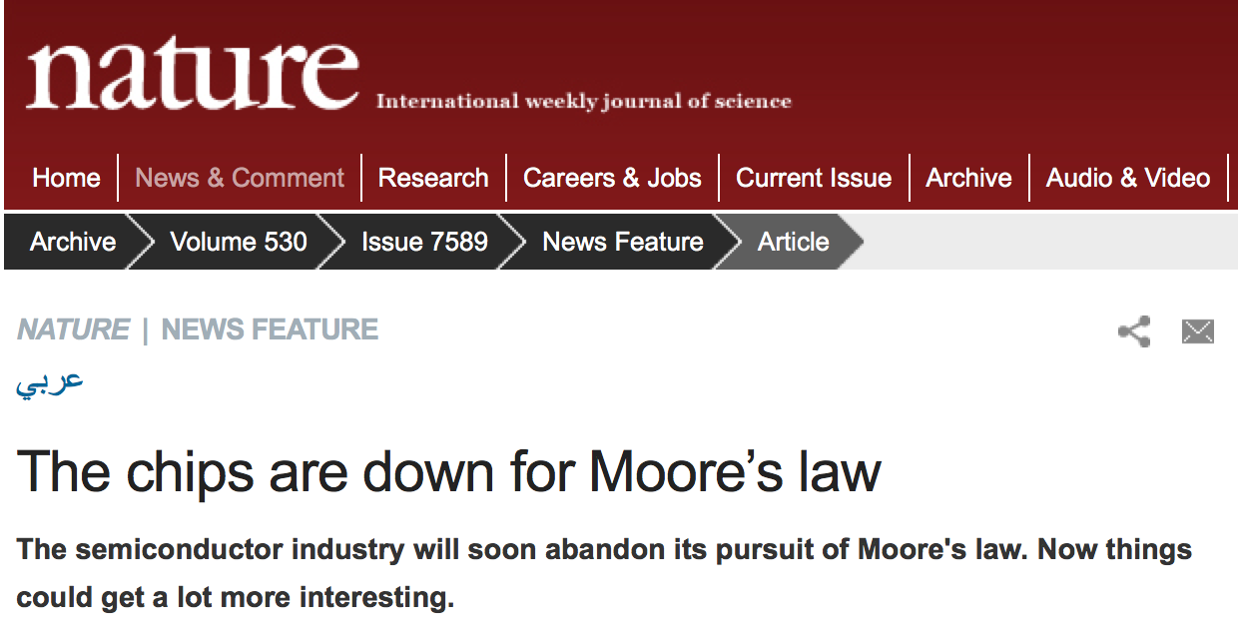
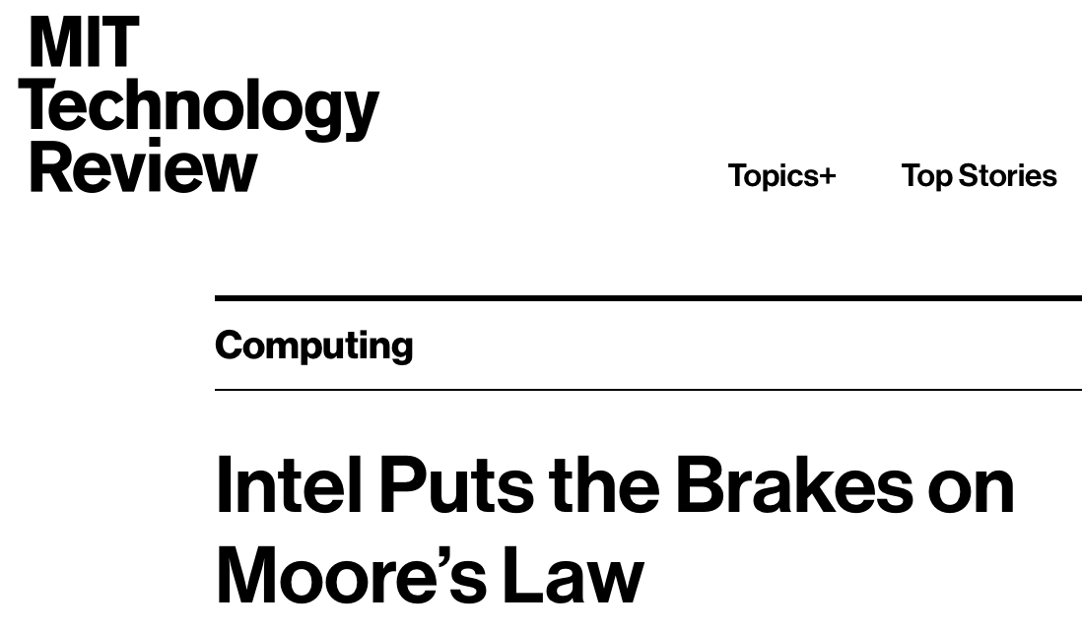
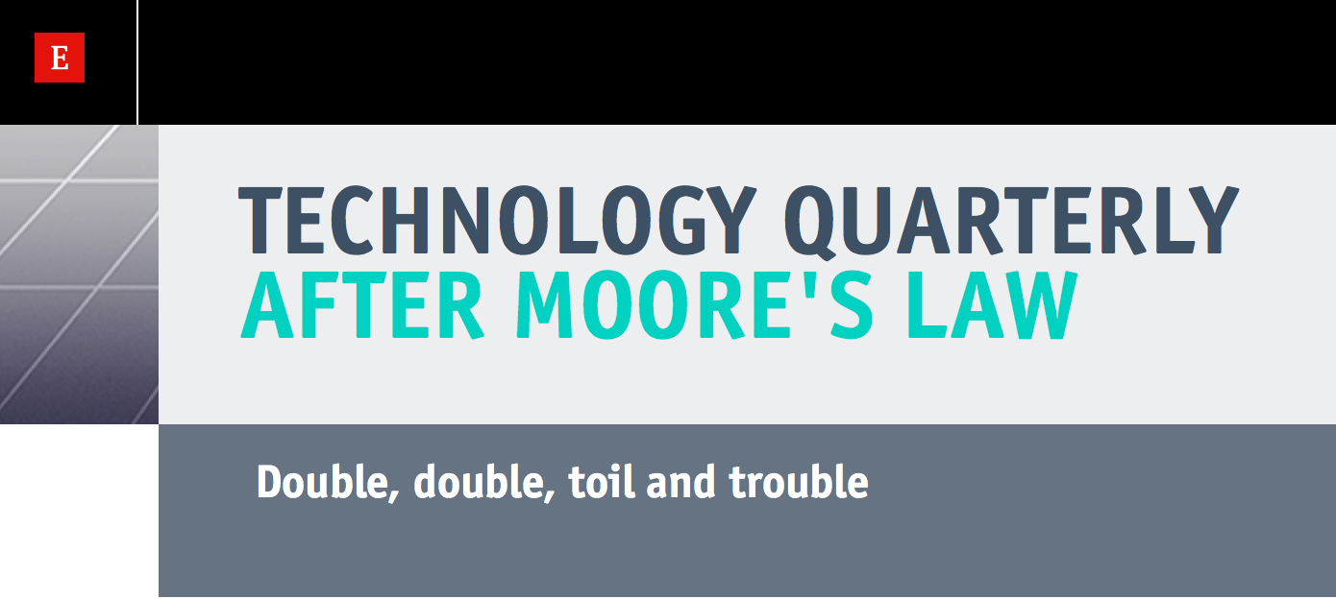
Moore’s law is slowing down

Slide 34
What does it mean?
CPUs affected most: only 15-20%/year perf. improvements
More complex layouts, harder to scale
Exploring these improvements hard → parallel programs
Memory: still grows at 30-40%/year
Regular layouts, stacked technologies
Network: grows at 30-50%/year
100/200/400GBpE NICs at horizon
Full-bisection bandwidth network topologies
CPUs is the bottleneck and it’s getting worse!

Slide 35
What does it mean?
CPUs affected most: only 15-20%/year perf. improvements
More complex layouts, harder to scale
Exploring these improvements hard → parallel programs
Memory: still grows at 30-40%/year
Regular layouts, stacked technologies
Network: grows at 30-50%/year
100/200/400GBpE NICs at horizon
Full-bisection bandwidth network topologies
Memory-to-core ratio increasing
e.g., AWS: 7-8GB/vcore → 17GB/vcore (X1)

Slide 36
Unprecedented hardware innovation
From CPU to specialized chips:
GPUs, FPGAs, ASICs/co-processors (e.g., TPU)
Tightly integrated (e.g., Intel’s latest Xeon integrates CPU & FPGA)
New memory technologies
HBM (High Bandwidth Memory)

Slide 37
High Bandwidth Memory (HBM)
2 channels @ 128 bits
8 channels = 1024 bits

Slide 38
High Bandwidth Memory (HBM)
8 stacks = 4096 bits → 500 GB/sec

Slide 39
Unprecedented hardware innovation
From CPU to specialized chips:
GPUs, FPGAs, ASICs/co-processors (e.g., TPU)
Tightly integrated (e.g., Intel’s latest Xeon integrates CPU & FPGA)
New memory technologies
HBM2: 8 DRAM chips/package → 1TB/sec

Slide 40
Unprecedented hardware innovation
From CPU to specialized chips:
GPUs, FPGAs, ASICs/co-processors (e.g., TPU)
Tightly integrated (e.g., Intel’s latest Xeon integrates CPU & FPGA)
New memory technologies
HBM2: 8 DRAM chips/package → 1TB/sec
3D XPoint

Slide 41
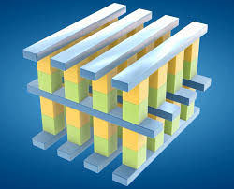
3D XPoint Technology
Developed by Intel and Micron
Announced last year; products released this year
Characteristics:
Non-volatile memory
2-5x DRAM latency!
8-10x density of DRAM
1000x more resilient than SSDs

Slide 42
Unprecedented hardware innovation
From CPU to specialized chips:
GPUs, FPGAs, ASICs/co-processors (e.g., TPU)
Tightly integrated (e.g., Intel’s latest Xeon integrates CPU & FPGA)
New memory technologies
HBM2: 8 DRAM chips/package → 1TB/sec
3D XPoint
“Renaissance of hardware design” – David Patterson

Slide 43
Overview
Application trends
Hardware trends
Challenges and techniques

Slide 44
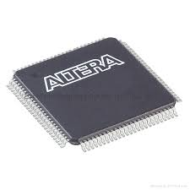
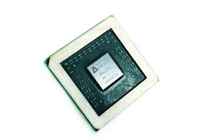
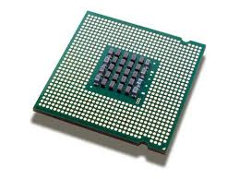
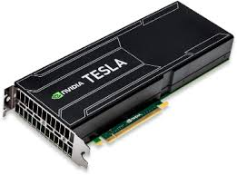
Complexity – Computation
Software
Software
CPU
CPU
GPU
FPGA
ASIC
+
SGX

Slide 45
Complexity – Memory
2015
2020
L1/L2 cache
~1 ns
L1/L2 cache
~1 ns
L3 cache
~10 ns
L3 cache
~10 ns
HBM
~10 ns / ~1TB/s / ~10GB
Main memory
~100 ns / ~80 GB/s / ~100GB
Main memory
~100 ns / ~80 GB/s / ~100GB
NVM (3D Xpoint)
~1 usec / ~10GB/s / ~1TB
NAND SSD
~100 usec / ~10 GB/s / ~1 TB
NAND SSD
~100 usec / ~10 GB/s / ~10 TB
Fast HHD
~10 msec / ~100 MB/s / ~10 TB
Fast HHD
~10 msec / ~100 MB/s / ~100 TB

Slide 46
Complexity – more and more choices
Basic tier: A0, A1, A2, A3, A4
Optimized Compute : D1, D2, D3, D4, D11, D12, D13
D1v2, D2v2, D3v2, D11v2,…
Latest CPUs: G1, G2, G3, …
Network Optimized: A8, A9
Compute Intensive: A10, A11,…
t2.nano, t2.micro, t2.small
m4.large, m4.xlarge, m4.2xlarge, m4.4xlarge, m3.medium, c4.large, c4.xlarge, c4.2xlarge,
c3.large, c3.xlarge, c3.4xlarge,
r3.large, r3.xlarge, r3.4xlarge,
i2.2xlarge, i2.4xlarge, d2.xlarge d2.2xlarge, d2.4xlarge,…
n1-standard-1, ns1-standard-2, ns1-standard-4, ns1-standard-8, ns1-standard-16, ns1highmem-2, ns1-highmem-4, ns1-highmem-8, n1-highcpu-2, n1-highcpu-4, n1-highcpu-8, n1-highcpu-16, n1-highcpu-32, f1-micro, g1-small…
Microsoft AZURE
Amazon EC2
Google Cloud Engine

Slide 47
Complexity – more and more constraints
Latency
Accuracy
Cost
Security

Slide 48
Techniques of conquering complexity
Use additional choices to simplify!
Expose and control tradeoffs
Don’t forget “tried & true” techniques

Slide 49
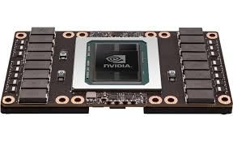
Use choices to simplify!
Example: NVIDIA DGX-1 supercomputer for Deep Learning
…
Pascal P100
HBM
(720TB/s / 16GB)
HBM
(720TB/s / 16GB)
HBM
(720TB/s / 16GB)
100 GB/s
Persistent des-aggregate storage
(NAND SSDs, 25usec / 100 Gbps / 7 TB)

Slide 50
Use choices to simplify!
Possible datacenter architecture (e.g., FireBox, UC Berkeley)
L1/L2 cache
L1/L2 cache
L1/L2 cache
…
L3 cache
L3 cache
L3 cache
Main memory
Main memory
Main memory
Ulta-fast persistent des-aggregated storage
(~10 usec / ~ 10 GBs / ~ 1 PB)

Slide 51
Expose and control tradeoffs
Latency vs. accuracy
Approximate query processing (e.g., BlinkDB)
Decompose ML algos: light weight, ensemble and correction model (e.g., Clipper)
Latency (response time) vs. cost
Predict response times given configuration (e.g., Earnest)
Security vs. latency vs. accuracy
E.g., CryptDB, Opaque

Slide 52
“Tried & true” techniques
Sampling
Scheduling (e.g., Sparrow), computation (e.g., BlinkDB), storage (e.g., KMN)
Batching
Scheduling (e.g., Drizzle)
Speculation:
Replicate time-sensitive requests/jobs (e.g., Dolly)
Incremental algorithms
Updates (e.g., IndexedRDDs), and Machine Learning (e.g., Clipper)

Slide 53
Summary
We are at an inflection point both in terms of apps and hardware trends, and RISE lab is at the intersection of it
Many opportunities
Be aware of “complexity”: use myriad choices available to simplify!

